Slide 1
Remote Network Access

Slide 2
Introduction to Transport layer
Functions of Transport Layer
What is Public Network
Wide , Availability connectivity and but not secured
What Is private Network ??
Security
Virtual Private Network

Slide 3
What are the types of remote access?
Broadband
DSL Lines
Mobile Network
Satellite Links

Slide 4
Remote access is the ability for an authorized person to access a computer or network from a geographical distance through a network connection
Remote access is accomplished with a combination of software, hardware and network connectivity
Software: Using a secure software solution like a VPN
Hardware: By connecting hosts through a hard-wired network interface or Wi-Fi network interface
Network: By connecting via the internet
Remote Access Protocols
PPP, PPPoE,PPTP, IPSEC, L2TP
Remote Authentication Dial-In User Service (RADIUS)
Terminal Access Controller Access Control System (TACACS)

Slide 5
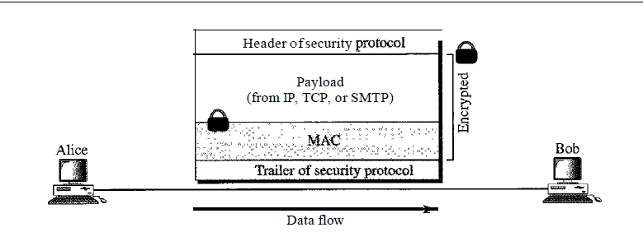
Generic approach
security aspects, particularly privacy and message authentication, can be applied to the network, transport, and application layers of the Internet model

Slide 6
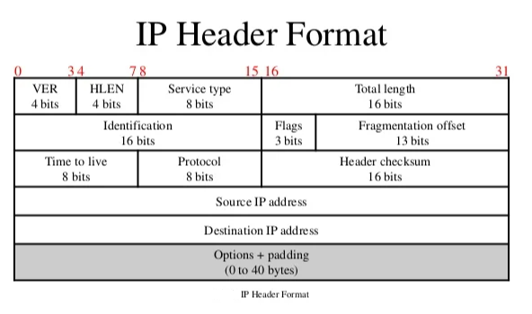

Slide 7
IP Security (IPSec)
Confidentiality: by encrypting our data, nobody except the sender and receiver will be able to read our data.
Integrity: we want to make sure that nobody changes the data in our packets. By calculating a hash value, the sender and receiver will be able to check if changes have been made to the packet.
Authentication: the sender and receiver will authenticate each other to make sure that we are really talking with the device we intend to.
Anti-replay: even if a packet is encrypted and authenticated, an attacker could try to capture these packets and send them again. By using sequence numbers, IPsec will not transmit any duplicate packets.

Slide 8
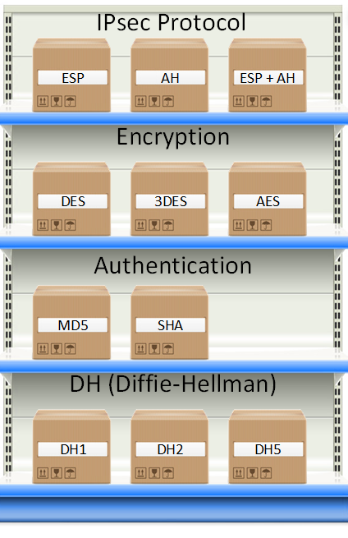

Slide 9
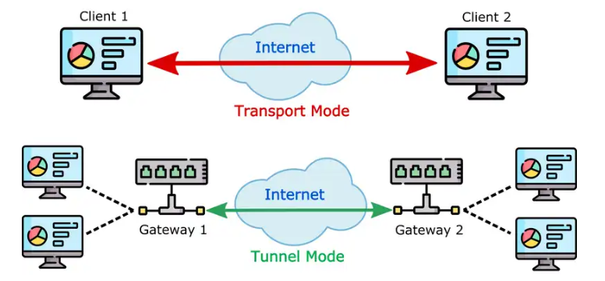
IP Security (IPSec)
Internet Engineering Task Force (IETF) to provide security for a packet at the network level
IPSec operates in one of two different modes: the transport mode or the tunnel mode

Slide 10
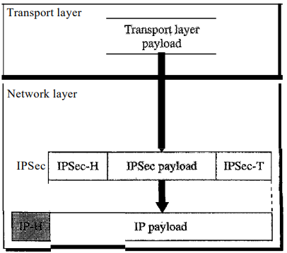
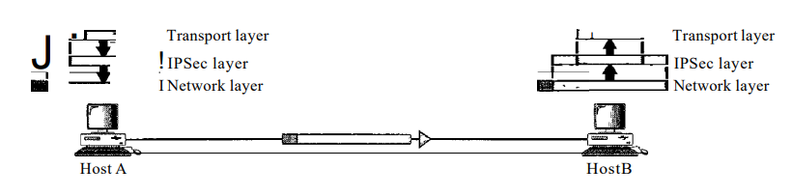
Transport Mode
IPSec in the transport mode does not protect the IP header
it only protects the information coming from the transport layer

Slide 11
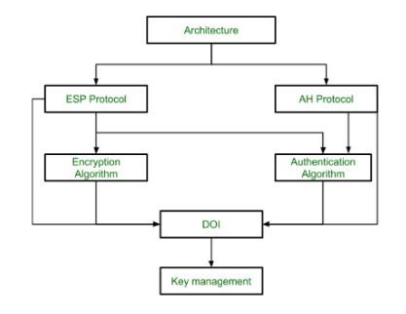
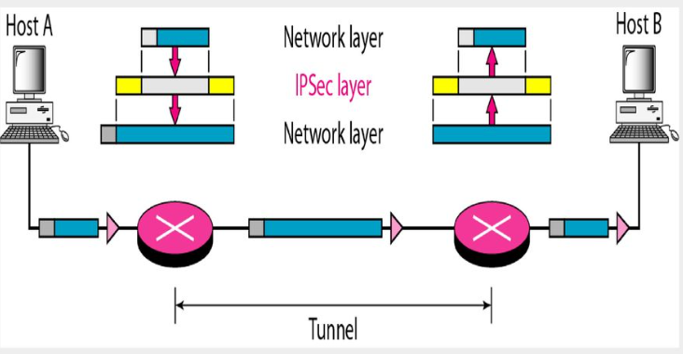
Tunnel Mode
In the tunnel mode, IPSec protects the entire IP packet
It takes an IP packet, including the header, applies IPSec security methods to the entire packet, and then adds a new IPheader as shown in Figure
The new IP header, as we will see shortly, has different information than the original IF header.
The tunnel mode is normally used between two routers, between a host and a router, or between a router and a host as shown in Figure

Slide 12
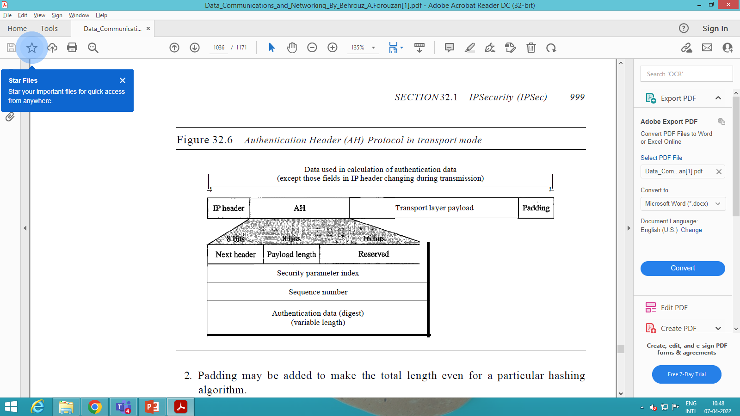
Tunnel Mode : Two Security Protocols
Authentication Header (AH)
The Authentication Header (AH) Protocol is designed to authenticate the source host and to ensure the integrity of the payload carried in the IP packet.
The protocol uses a hash function and a symmetric key to create a message digest; the digest is inserted in the authentication header

Slide 13
AH protocol provides a mechanism for authentication only
AH provides data integrity, data origin authentication, and an optional replay protection service
digest that is generated by an algorithm such as HMAC-MD5 or HMAC-SHA
Replay protection is provided by using a sequence number field with the AH header
AH authenticates IP headers and their payloads, with the exception of certain header fields that can be legitimately changed in transit, such as the Time To Live (TTL) field

Slide 14
Next header
The 8-bit next-header field defines the type of payload carried by the IP datagram (such as TCP, UDP, ICMP, or OSPF)
It has the same function as the protocol field in the IP header before encapsulation
Payload length
it defines the length of the authentication header in 4-byte multiples, but it does not include the first 8 bytes
Security parameter index.
The 32-bit security parameter index (SPI) field plays the role of a virtual-circuit identifier and is the same for all packets sent during a connection called a security association
Sequence number
A 32-bit sequence number provides ordering information for a sequence of datagrams
Authentication data
Finally, the authentication data field is the result of applying a hash function to the entire IP datagram except for the fields that are changed during transit (e.g., time-to-live)

Slide 15
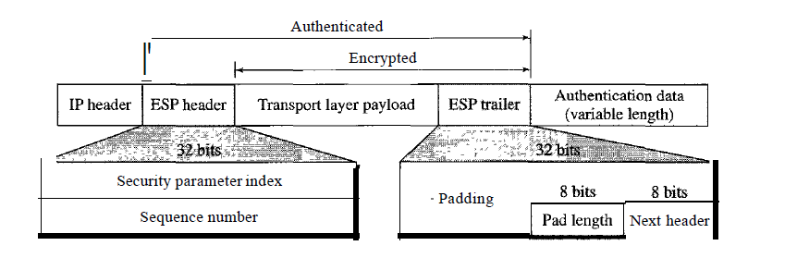
Encapsulating Security Payload (ESP)
The AH Protocol does not provide privacy, only source authentication and data integrity
an alternative protocol that provides source authentication, integrity, and privacy called Encapsulating Security Payload (ESP)
ESP adds a header and trailer. Note that ESP's authentication data are added at the end of the packet which makes its calculation easier.
Figure shows the location of the ESP header and trailer.
ESP provides source authentication, data integrity, and privacy

Slide 16
In tunnel mode, the entire original IP packet is encapsulated to become the payload of a new IP packet. Additionally, a new IP header is added on top of the original IP packet. Since a new packet is created using the original information, tunnel mode is useful for protecting traffic between different networks. An additional advantage of this mode is that it makes it very easy to establish a “tunnel” between two secure IPsec gateways.
These IPsec gateways in turn can connect two different networks securely. Using secure IPsec proxies like the ones shown in the diagram below can be very useful for connecting two distant branches using an encrypted connection.

Slide 17
The process used by IPsec to encapsulate the original IP header differs depending on whether AH tunnel mode or ESP tunnel mode is used:
The original packet is encapsulated in a new IP packet (both its IP header and its payload).
In the case of AH tunnel mode, an AH header and a new IP header are added. For ESP tunnel mode, an ESP header, a new IP header, an ESP trailer, and an ESP authentication trailer are added.
When AH tunnel mode is used, the entire packet is signed for integrity and authentication. But when ESP tunnel mode is used, the encapsulated packet between the ESP header and the ESP trailer is signed for integrity and authentication. The new packet can also be encrypted for greater security.

Slide 18
The main difference in transport mode is that it retains the original IP header. In other words, payload data transmitted within the original IP packet is protected, but not the IP header. In transport mode, encrypted traffic is sent directly between two hosts that previously established a secure IPsec tunnel
Since a new IP header isn’t created, the process used by transport mode is less complex than tunnel mode:
Depending on the protocol used, a new AH or ESP header is created and inserted just after the original IP header.
For the ESP protocol, both an ESP trailer and an ESP authentication trailer are created and added after the original package.
When using AH transport mode, the entire packet is signed for integrity and authentication. For ESP transport mode, the original packet payload is signed by authentication (that is, not including its IP header) and encrypted if required.

Slide 19
SSL VPN
What is SSL / TSL ????
SSL VPNs use browser-based protocols to create secure tunnels between a user’s device and an SSL VPN gateway.
This end-to-end-encrypted (E2EE) tunnel gives remote users easy access to protected resources
Although they kept the name of their original Secure Sockets Layer (SSL) protocol, today’s SSL VPNs use the more secure Transport Layer Security (TLS) protocol
Enterprises use SSL VPNs to enable remote users to securely access organizational resources, as well as to secure the internet sessions of users who are accessing the internet from outside the enterprise

Slide 20
How SSL VPNs work?
SSL VPNs enable authenticated users to establish secure connections to internal HTTP and HTTPS services via standard web browsers or client applications that enable direct access to networks
There are two primary types of SSL VPNs: VPN portal and VPN tunnel
An SSL portal VPN enables one SSL VPN connection at a time to remote websites
Remote users access the SSL VPN gateway with their web browser after they have been authenticated through a method supported by the gateway
Access is gained via a webpage that acts as a portal to other services
An SSL tunnel VPN sends your internet traffic through a secure VPN tunnel
This type of VPN allows you to use a web browser to access multiple network services, including services that may not be web-based, such as enterprise software or proprietary networks
SSL tunnel VPNs can be especially useful for enterprises if they have applications or networks that are otherwise inaccessible remotely.

Slide 21
PPTP
PPTP enables the secure transfer of data from a remote client to a private enterprise server by creating a virtual private network (VPN) across TCP/IP-based data networks
PPTP supports on-demand, multi-protocol, virtual private networking over public networks, such as the Internet
PPTP is a network protocol that encapsulates PPP packets into IP datagrams for transmission over the Internet or other public TCP/IP-based networks. PPTP can also be used in private LAN-to-LAN networking
PPTP is its support for virtual private networking by using public-switched telephone networks (PSTNs)

Slide 22
Generally, there are three computers involved in every PPTP deployment:
PPTP client network access server PPTP server
Generic Routing Encapsulation, or GRE, is a protocol for encapsulating data packets that use one routing protocol inside the packets of another protocol. "Encapsulating" means wrapping one data packet within another data packet, like putting a box inside another box.
NetBEUI (NetBIOS Extended User Interface) is an extended version of NetBIOS, the primary software that allows individual computers to communicate within a given local area network.
While NetBIOS itself is most often used to transfer pictures, documents, videos, or other files from one computer to another, NetBEUI is responsible for arranging the actual information in a data transmission. As a result, NetBIOS cannot transfer files or share access rights between two computers without the NetBEUI extension

Slide 23
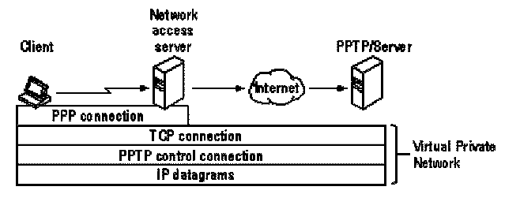
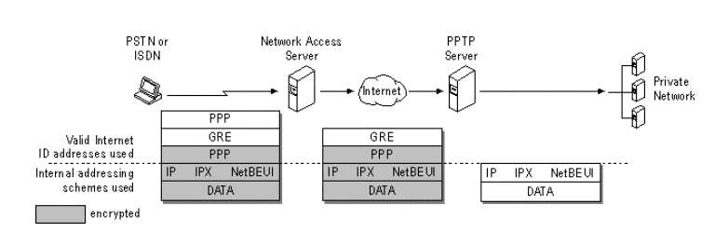

Slide 24
Layer 2 Tunnel Protocol
Layer 2 Tunneling Protocol (L2TP) connections, which are also called virtual lines, provide cost-effective access for remote users by allowing a corporate network systems to manage the IP addresses assigned to its remote users
Further, L2TP connections provide secure access to your system or network when you use them in conjunction with IP Security (IPSec)

Slide 25
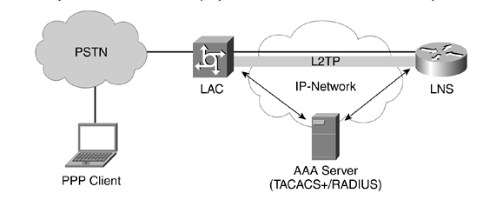
L2TP Access Concentrator (LAC)
The LAC receives data from remote devices and routes it securely to the LNS. The LAC negotiates a Point-to-Point (PPP) connection to transmit data frames. It could reside in company data centers, but LACs can also be integrated into ISPs to route L2TP traffic across the internet.
L2TP Network Server (LNS)
The LNS is at the other end of the L2TP tunnel and functions as the termination point for PPP sessions. It acts as a gateway between public and private networks and allows encrypted traffic to access network assets.

Slide 26
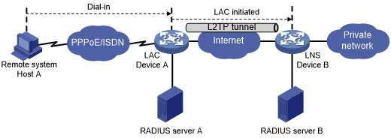
NAS-initiated tunneling mode
The remote system only needs to support PPP, and it does not need to support L2TP.
Authentication and accounting of the remote system can be implemented on the LAC or LNS.

Slide 27
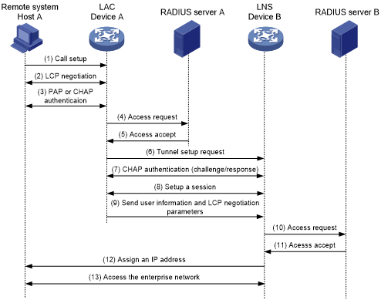

Slide 28
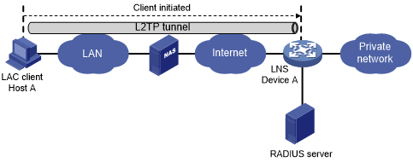
Client-initiated tunneling mode

Slide 29
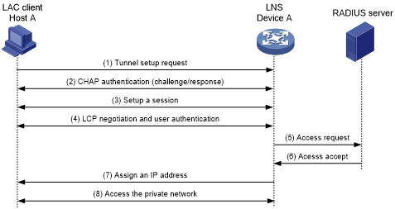
Client-initiated tunnel establishment process

Slide 30
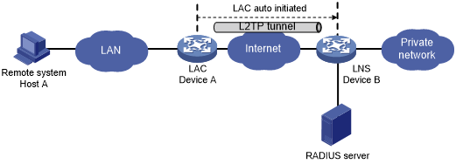
LAC-auto-initiated tunneling mod

Slide 31
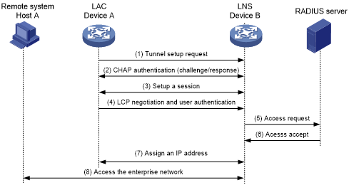
Establishment process for LAC-auto-initiated tunnels

Slide 32
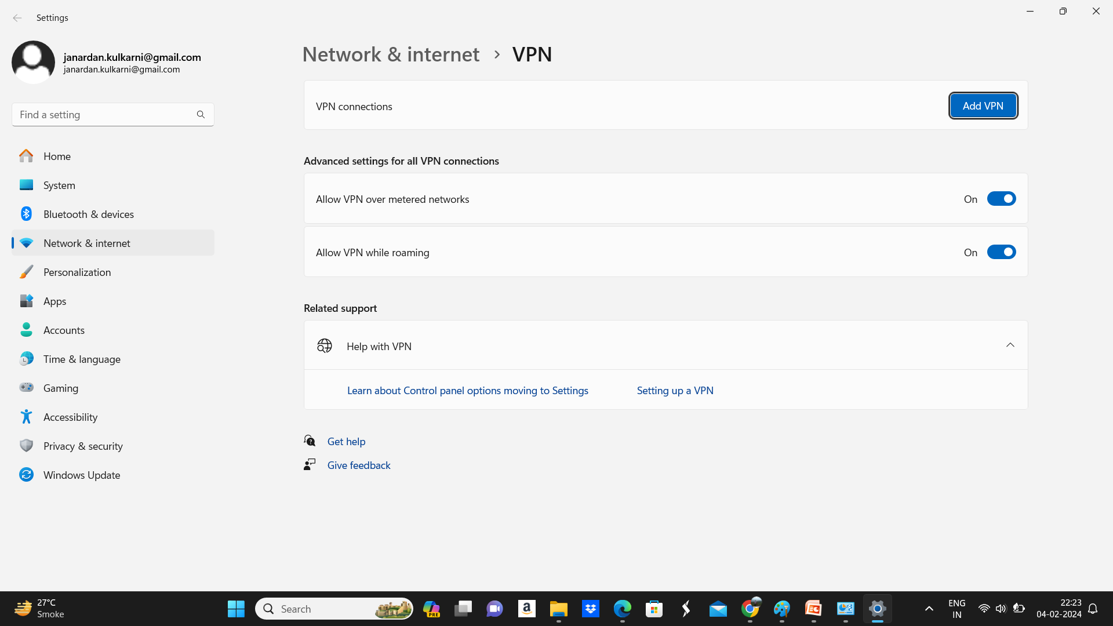

Slide 33
